Slide 1
Interstate Compact for Juveniles
DCBS Training
Updated March 2019

Slide 2
Interstate Compact for Juveniles
The Interstate Compact for Juveniles (ICJ) is a legislatively adopted contract between the states that provides for supervision and return of juveniles who:
Have run away from home and left their state of residence;
Are on probation, parole or other supervision, or have escaped to another state; and/or
Have been accused of an offense in another state.

Slide 3
Compact Clause
The Compact is authorized by the Compact Clause of the U.S. Constitution and the Crime Control Act, 4 USC (1965). The Compact specifically requires all court and executive agencies to enforce the Compact and to take necessary actions to effectuate its purpose. The ICJ and ICJ Rules have the full force and effect of federal law

Slide 4
Legal Status of Interstate Compacts
All member states must meet their contractual obligations by complying with and enforcing the Compact and its rules
KRS 615.010 Interstate Compact for Juveniles – Purpose – Definitions – Commission – Powers – Organization, rulemaking, enforcement – Enactment by states – Withdrawal.
Notes:
Courts and executive agencies must enforce the Compact and its rules. See, Art. VII § A(2)
ICJ rules are binding on all states and their officials. Requirements of the ICJ extend to both state and county courts, probation authorities, paroling authorities and other agencies having responsibility for juveniles. Once adopted, the rules have the force and effect of statutory law and supersede any inconsistent and conflicting state laws.

Slide 5
ICJ Definitions
Runaway: persons within the juvenile jurisdictional age limit established by the home state who have voluntarily left their residence without permission of their legal guardian or custodial agency but who may or may not have been adjudicated.
Absconder: a juvenile probationer or parolee who hides, conceals, or absents him/herself with the intent to avoid legal process or authorized control.

Slide 6
ICJ Definitions Continued
Escapee: a juvenile who has made an unauthorized flight from in custody status or a facility to which he/she has been committed by a lawful authority. (i.e.: committed juveniles to DCBS or DJJ)
Juvenile runaways from other states can be detained.
The Juvenile Justice Delinquency Prevention Act (JJDPA, which limits detention of “status offenders.” Specifically allows detention of minors pursuant to the ICJ. 42 U.S.C. 5633 (a)

Slide 7
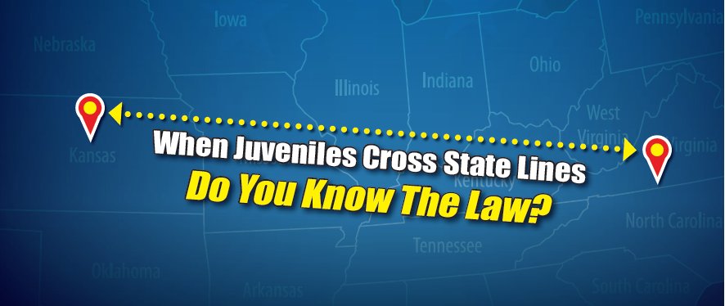

Slide 8
KY Interstate Compact for Juveniles
Anytime a juvenile has run away and crossed state lines without permission of a parent or guardian, the Kentucky ICJ Office may become involved.
ICJ works with parents, detention centers, Judges, CDW’s, DCBS, DJJ and family members, not just DJJ.

Slide 9
Communication Rule
Anytime you are in court, receive a phone call, or receive information concerning a juvenile that resides out of state, please contact KY ICJ immediately to make sure we are aware that the juvenile is in Kentucky.
Please do not give out any information or communicate with locals from other states. Please advise them to contact their local ICJ Office.
All communications between states, whether verbal or written, on ICJ issues shall be transmitted between the respective ICJ Offices. ICJ Rule 2-104

Slide 10
Interstate Compact on the Placement of Children (ICPC)
ICPC is an agreement between member states that governs the placement of abused, neglected or dependent children into another state. ICPC provides these children the same protections and services that would be provided to them if they remained in their home state. ICPC also governs children placed as a result of an independent or private adoption and all children (including delinquents) placed into residential treatment facilities. ICPC includes the return of the child to the original jurisdiction should the placement proved not to be in the best interest of the child.
Notes:
KY has passed the new Interstate Compact on the Placement of Children but is not operating under it as yet because it has not been ratified in 35 states (the requirement for nationwide implementation.

Slide 11
MOU between ICPC and ICJ
A Memorandum of Understanding (MOU) was entered into between the Interstate Commission for Juveniles and the Association of Administrators of the Interstate Compact on the Placement of Children on May 21, 2012.
The purpose of the MOU is to foster communication, collaboration, education and training to clarify issues and resolve confusion at the local, state and national levels in the handling of those cases when both compacts may apply or in other cases when only one compact is to be used.

Slide 12
Returning Juveniles

Slide 13
Situations Requiring Return of Juvenile
A non-delinquent juvenile runs away to another state
A juvenile is an escapee, absconder, or accused delinquent and flees to another state
A placement fails for a juvenile under Interstate Compact for Juvenile’s supervision
Return can be voluntary or non-voluntary

Slide 14
Non-Delinquent Runaways
Within 24 hours of detainment, authorities may release a runaway to a parent or legal guardian without applying Rule 6-102
Except where instances of abuse/neglect is suspected
After 24 hours, the Compact must be applied
Runaways are held in secure facilities if detained longer than 24 hours or if they are endangering themselves or others
OJJDP Exclusion
Juveniles held pursuant to the ICJ are excluded from the deinstitutionalization of status offenders requirements. See, Notice of Clarification of OJJDP Policy on Secure Detention of Runaways
Rule 6-101
Notes:
Juvenile authorities may release a runaway to their parent or legal guardian within the first 24 hours of detainment. This excludes weekends and holidays and cases where abuse or neglect are suspected.
If the parent or legal guardian is unable or unwilling to pick up the juvenile within that timeframe, Rule 6-102 due process procedures must be used and the holding state is notified. Runaways who are endangering themselves or others or held beyond the 24 hours, shall be held in secure facilities until returned by the home state.
The home/demanding state works with the appropriate authority and/or court of jurisdiction to effect the safe return of the juvenile. It is the home/demanding state’s responsibility to determine the residency and jurisdictional facts of the runaway.
OJJDP Exclusion
Out-of-State runaways securely held beyond 24 hours solely for the purpose of being returned to proper custody in another state in response to a want, warrant, or request from a jurisdiction in the other state or pursuant to a court order must be reported as violations of the deinstitutionalization of status offenders requirements.
Juveniles held pursuant to the Interstate Compact for Juveniles enacted by the state are excluded from the deinstitutionalization of status offenders requirements in total.

Slide 15
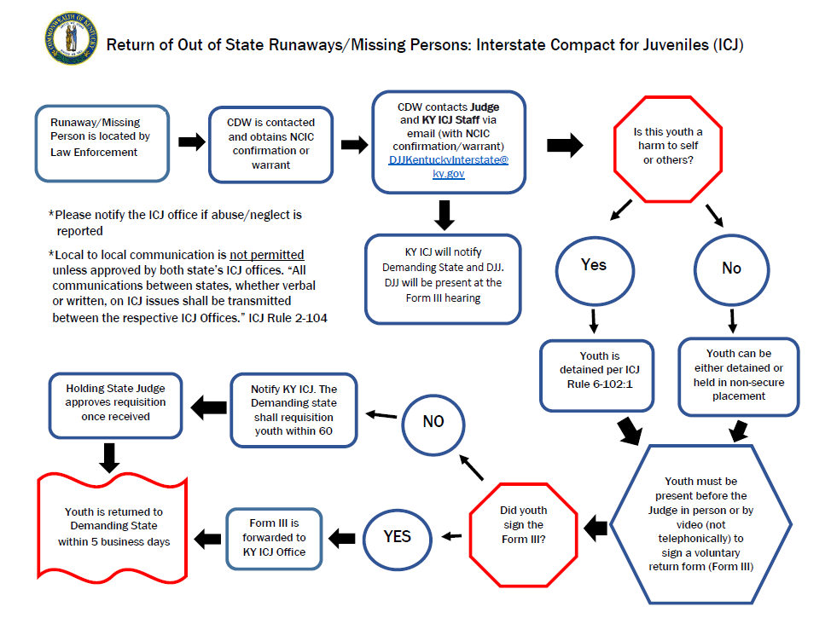

Slide 16
Voluntary Return of Runaways
Judge conducts a hearing informing juvenile of rights
May use ICJ Juvenile Rights Form
The court may appoint counsel or guardian ad litem
The juvenile and the judge sign the ICJ Form III
Holding state forwards the completed ICJ Form III to the home/demanding state within 5 business days
For voluntary return of runaways who allege abuse/neglect:
The Form III must indicate who will be assuming responsibility for the juvenile
Rules 6-101, 6-102
Notes:
If a juvenile is held for longer than 24 hours, the holding state conducts a hearing for the juvenile where the judge informs the juvenile of their rights.
The court may elect to appoint counsel or a guardian ad litem to represent the juvenile in this process.
If the juvenile agrees to the return, he/she will sign ICJ Form III in the presence (electronic or physical) of Judge who will also sign, consenting to return voluntarily. This applies to non-delinquent juveniles, probation and parole absconders, escapees, and juveniles accused of being delinquent.
The holding state completes the Form III and forwards a copy to the home/demanding state.

Slide 17
Non-Voluntary Returns - Overview
The non-voluntary return process is divided into two distinct processes:
Returning non-delinquent runaways; and
Returning juveniles who are escapees, absconders, or accused delinquents
Home/demanding state prepares a requisition within 60 calendar days of notification that:
The juvenile refuses to return; or
Request the juvenile be taken into custody
Rule 6 -103
Notes:
To effect such a return, the appropriate authority in the home/demanding state prepares a written requisition within 60 calendar days of being notified that a.) the juvenile refuses to return voluntarily or b.) to request the court to take into custody a juvenile who is located in their jurisdiction.
Once in detention, such a juvenile may be held, pending non-voluntary return to the home/demanding state, for a maximum of 90 calendar days. The home/demanding state must maintain regular contact with the authorities preparing the requisition to ensure their accurate preparation and timely delivery to minimize detention time.

Slide 18
Hearings for Non-Voluntary Returns
Within 30 days of receiving a requisition, a hearing occurs in the state where the juvenile is located
The juvenile may elect to have counsel or guardian ad litem
If requisition is in order: Judge orders juvenile’s return
If requisition is denied: Judge shall issue written findings detailing the denial
Rule 6-103

Slide 19
Non-Voluntary Returns - Last Steps
The court forwards order to the holding state
Holding state forwards order to the home/demanding state
The juvenile is returned within 5 business days of receipt of the order granting requisition
Requisitioned juveniles shall be accompanied
Officers shall transport juveniles through all member states without interference
Rule 6-103

Slide 20
DCBS SOP 10.13 Intro to Compliance with ICJ
A child from another state apprehended in Kentucky, as a runaway must be returned to their home state through the Interstate Compact for Juveniles (ICJ). Likewise, the same procedure is applied for children from Kentucky who have fled to another state. The Justice Cabinet, Department of Juvenile Justice, is responsible for administering ICJ procedures.

Slide 21
10.13 Continued
Procedure:
Notifies the Interstate Compact for Juveniles office at 502-573-2738 within twenty-four (24) hours, exclusive of weekends and holidays, in the event that a child from another state is picked up as a runaway;
Refers the report to the Interstate Compact for Juveniles office if notification is received that a runaway child from Kentucky has been picked up in another state.

Slide 22
ICJ and DCBS ESCAPEES
A youth committed to DCBS or DJJ who run across state lines is considered an escapee.
During FY 18, Kentucky returned 14 of the 34 total escapees Nationwide.

Slide 23
Pick-Up Orders & Warrants
All warrants must be entered into the National Crime Information Center (NCIC)
Holding state honors all warrants
The holding state notifies the home/demanding state by the next business day that the juvenile is in custody
The home/demanding state has 2 business days to decide if they will return the juvenile
Rule 6-108
Notes:
All warrants under ICJ jurisdiction shall be entered into the National Crime Information Center (NCIC) by the appropriate local law enforcement agency or other authorized agency in the issuing state. Holding states shall honor all lawful warrants as entered by other states and within the next business day notify the ICJ office in the home/demanding state that the juvenile has been placed in custody pursuant to the warrant. Within two (2) business days of notification, the home/demanding state shall inform the holding state whether the home/demanding state intends to have the juvenile returned.
When the home/demanding state enters a warrant into NCIC as a "no bond/bail warrant" but the holding state's statutes allow for bond/bail on juvenile warrants, the holding state shall not release the juvenile in custodial detention on bond/bail. However, a juvenile subject to detention shall be afforded an opportunity for a hearing pursuant to ICJ Rule 6-109.

Slide 24
Transporting Juveniles
The home/demanding state is responsible for the costs of transportation and for making transportation arrangements.
If the juvenile is a safety risk, they are to be accompanied on their return.
All transportation arrangements must go through the ICJ office.
If DJJ Committed juvenile, DJJ pays the cost of transportation.
If DCBS committed juvenile, DCBS pay the cost of transportation.
If airfare is determined to be the mode of transportation ICJ-KY office will help facilitate and/or arrange airport surveillance.
Rule 6-103, 6-105, 6-106

Slide 25
Liability
All Compact member states can be held liable for circumventing or violating the ICJ rules
There is a legal obligation to follow and enforce the ICJ rules as written
Notes:
http://websters-online-dictionary.org/definition/liable

Slide 26
Question #1
Is ICJ the same as ICPC?
Serving Juveniles While Protecting Communities
26
Notes:
26
Crime Control Act, 4 U.S.C. Section 112 (1965): Authorizes the creation of compacts for cooperative efforts and mutual assistance in the prevention of crime.
Congressional consent transforms the states’ agreement into federal law

Slide 27
Question #2
What if my state/jurisdiction has policies or laws that may potentially conflict with the ICJ and its rules?
27
Notes:
27
All compacting states’ laws conflicting with this compact are superseded to the extent of the conflict
No court can order relief inconsistent with the purpose of the compact
A state law that would conflict with or attempt to supersede the Revised ICJ would be unenforceable as either a
Breach of contract and/or
Violation of federal law

Slide 28
Question #3
Does a judge have the authority to bypass the procedures and rules of ICJ?
28
Notes:
28
The ICJ is a binding contract with other member states & statutory law
Article VII – The courts and executive agencies … shall enforce this compact and shall take all actions necessary and appropriate to effectuate the compact’s purposes and intent
All courts shall take judicial notice of the compact and the rules

Slide 29
Question #4
Does DCBS pay for the return of DCBS committed juveniles?
Does DCBS pay for the return of DJJ committed juveniles?
29
Notes:
29
The ICJ provides an alternative procedure to formal extradition proceedings
States still have the constitutional right to formally extradite a juvenile
Courts have held that an interstate compact authorized by Congress does not violate due process of law
A juvenile is bound by the terms of the Revised ICJ and its rules
A juvenile is subject to the alternative procedures provided in the Compact and its rules, not the provisions of the Uniform Criminal Extradition and Rendition Act (UCERA).

Slide 30
Contact Information
National Office
Interstate Commission for Juveniles
836 Euclid Avenue, Suite 322
Lexington, KY 40502
(859) 721-1063
(859) 721-1059 fax
www.juvenilecompact.org

Slide 31
Contact Information
Amy Welch
Commissioner/Deputy Compact Administrator
Interstate Commission for Juveniles (ICJ)
Department of Juvenile Justice (DJJ)
1025 Capital Center Dr. / 3rd Floor
Frankfort, KY 40601
(502) 573-2738
(502) 573-0836 fax
AmyP.Welch@KY.Gov
DJJKentuckyInterstate@KY.Gov

Slide 32
Contact Information
Anna Butler
ICJ Staff/Designee
Interstate Commission for Juveniles (ICJ)
Department of Juvenile Justice (DJJ)
1025 Capital Center Dr. / 3rd Floor
Frankfort, KY 40601
(502) 573-2738 x 316
(502) 573-0836 fax
AnnaE.Butler@KY.Gov
DJJKentuckyInterstate@KY.Gov

Slide 33
Questions?

